Slide 1
Distracted Driving Awareness

Slide 2

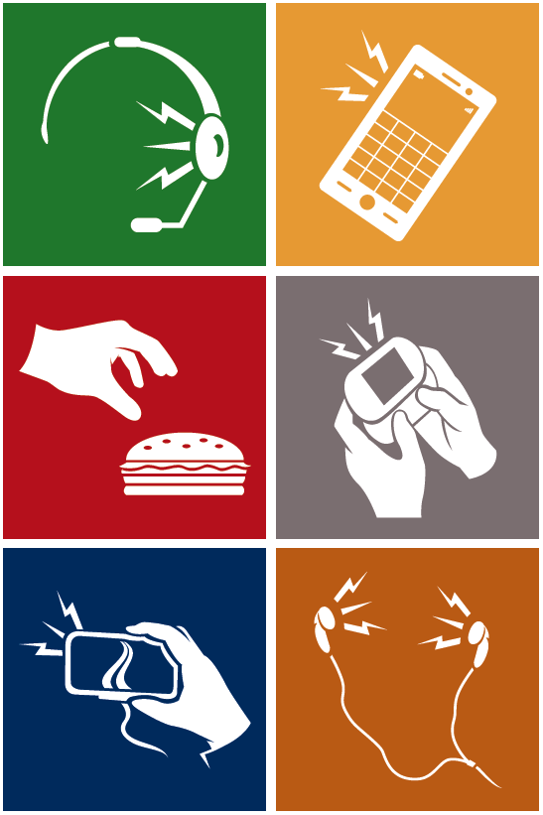
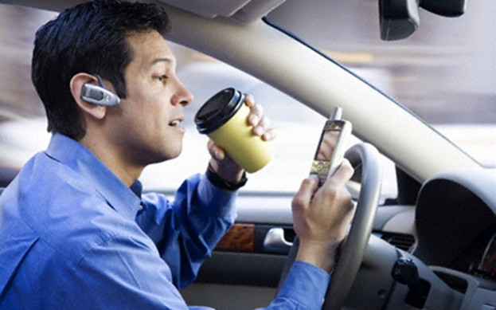

Avoid Distractions
NO DISTRACTIONS

Slide 3

Key Facts & Statistics
  More than 1 in 4 motor vehicle crashes involve cell phone use at the time of the crash
  Motor vehicle crashes are:
  #1 cause of death in the U.S. for 3-34 year olds
  #1 cause of work-related death

Slide 4

Key Facts & Statistics
20% of injury crashes involve distracted driving
  Over 400,000 people injured annually by distracted driving
16% of fatal crashes involve distracted driving
  Over 5,000 people killed annually by distracted driving

Slide 5

Key Facts & Statistics
Text messaging while driving creates a crash risk 23x worse than driving while not distracted
Sending or receiving a text takes a driver’s eyes from the road for an average of 4.6 seconds
The equivalent – at 55mph – of driving the length of an entire football field, blind.
Headset cell phone use is not any safer than hand-held use

Slide 6

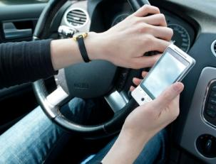
Key Facts & Statistics
Using a cell phone while driving – whether it’s hand-held or hands-free – delays a driver’s reactions and is the same as driving with a .08% blood alcohol content

Slide 7
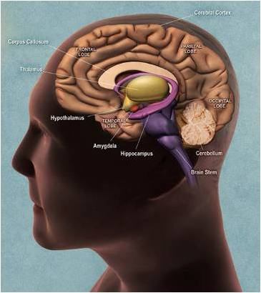
Key Facts & Statistics
Multitasking: A Brain Drain
Multitasking for the brain is a myth
Human brains do not perform two tasks at a time
The brain switches between one task and another
Driving needs ALL of your attention

Slide 8


Key Facts & Statistics
Driving while using a cell phone reduces the amount of brain activity associated with driving by 37%

Slide 9
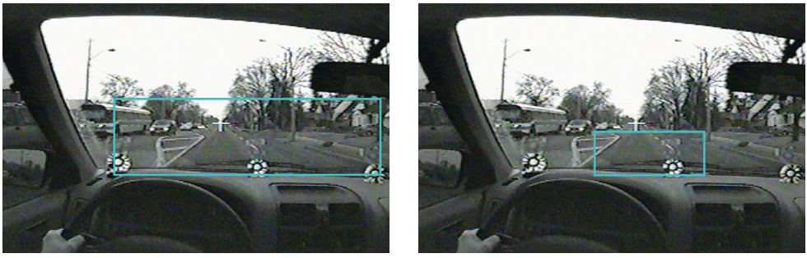
Inattention Blindness
When distracted, you experience “Inattention Blindness”
Even though you are looking, your distracted brain is not processing what you see effectively.
Where drivers not using a cell phone look
Where drivers using a hands-free cell phone look

Slide 10
URS Policy
URS Policy Change – SMS 057
The use of all mobile communication devices (MCDs) while driving is strictly prohibited
MCDs include
Employees may not use a
Personal or company MCD while driving a company or customer vehicle, including leased and rental vehicles
Company MCD while driving a personal vehicle
Hand-held mobile phones or two-way radios
Hands-free devices, including Bluetooth and headsets
Other portable electronic devices - tablets, PDAs, pagers, iPods, MP3s, GPS, DVD players, laptops, etc.
Personal MCD while driving a personal vehicle on company business
Driving includes the time spent in traffic or while stopped at red lights or stop signs

Slide 11
Distracted Driving Avoidance Tips
Before driving…
Schedule calls to not conflict with driving time
Schedule driving time in calendar as unavailable
New voicemail greeting:“…I’m unavailable or driving at the moment…”
Turn phone off and stow MCDs out of reach
Program GPS and mount on windshield / dash
Remove hands free device from vehicle
Smart phone apps may offer helpful solutions including auto-replying to incoming calls or texts when the vehicle is in motion.

Slide 12
Distracted Driving Avoidance Tips
While Driving…
Keep phone and MCDs out of reach
If you need to take or place a call or respond via two-way radio – pull over to a safe area (not on the highway)
Do not answer calls or check to see who is calling

Slide 13
Distracted Driving Avoidance Tips
When You’re a Passenger
Ask drivers not to talk on phones (including taxis)
Limit phone calls so as to not cause any distractions to the driver
Refuse to ride with a driver who is using phone or texting

Slide 14
Distracted Driving Avoidance Tips
When Calling Potential Drivers
Schedule calls when possible
Be cognizant of other’s travel status
Be patient – avoid multiple calls and follow-up texts
Ask if receiver is driving – if so, have them call you back

Slide 15
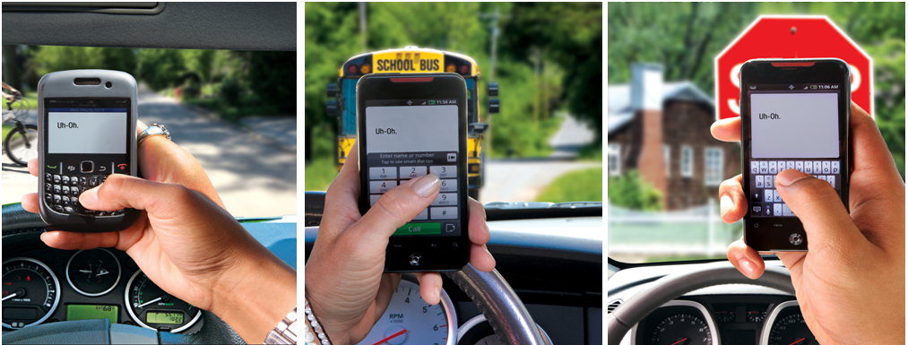
What you can’t see can hurt you…

