Slide 1

There is no such thing as a "stupid" or "daft" health and safety question!
H&S Auditing – Real World Examples
John Johnston
Health and Safety for Beginners (HSfB)
www.healthandsafetytips.co.uk
@hsfb
This file contains short bullet points of the basics of auditing, the intention being to share my experiences and to help with revision of NEBOSH and IOSH courses by providing real world examples. It’s not meant to be a detailed classroom lesson. I’ve based it on my own experiences within a heavy engineering manufacturing environment, but the principles and techniques are applicable across industries.
I’ve added in a few photo examples of some of my experiences during site tours of places I’ve visited over the past 12 years and the audit trails I followed. These are my photos, copyright is my own.
As with everything on Health and Safety for Beginners, it’s all yours for your own personal use, learning, training at your own place of work. Our terms and conditions do not allow publishing on any another internet site, or for selling and collecting any monies for personal gain.
Terms and Conditions - https://www.healthandsafetytips.co.uk/terms-of-use

Slide 2




We rely on word of mouth to keep HSfB thriving
Please share us, tell people about us, come back often
Thank you so much for your support

Slide 3

Contents
Why Audit?
The Audit Team
Good Auditor Qualities
The Audit – Plan, Prepare, Audit
It’s Your Audit
Recognising a Finding
Real World Examples
Auditing and behavioural safety, what does it look like? ABC Analysis
Site Inspection Photos

Slide 4
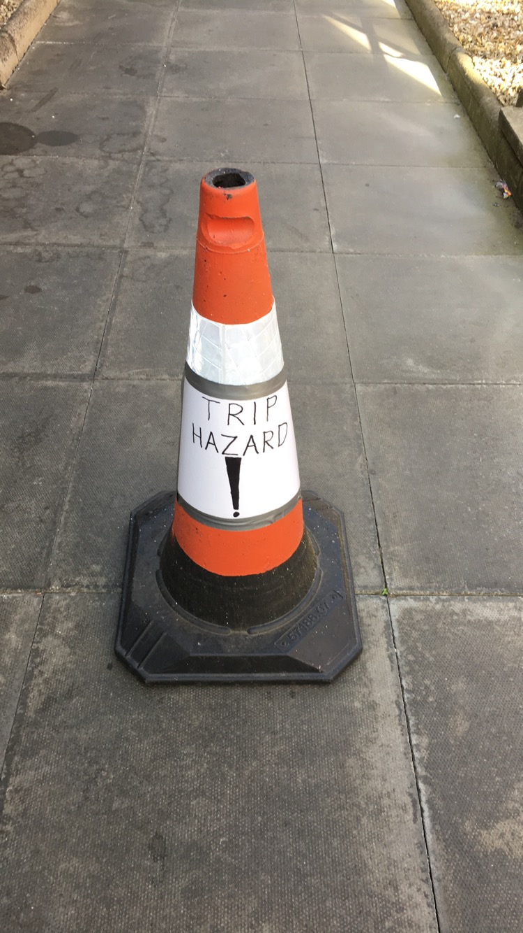
Why Audit?
  Typical definition - Auditing aims to find objective evidence for whether the current HSE management system complies with the organisation’s policies and objectives
Prevention
Moral
Legal
Contractual
Certification
To create an environment where we understand, respect and manage our risks, not one where we ‘feel’ safe - anon

Slide 5
The Audit Team
An effective audit team needs a competent lead auditor; one who has enough knowledge of health and safety management principles and pertinent legislation.
A typical team could include:
Trainee auditor
  personal development, bring their own experiences, knowledge and skillsets
Auditor
  trained to a minimum level of competence, mentor, personal development
Specialist input
  subject matter experts, i.e. pressure testing, mechanical lifting, radiography, design engineer, painter, scaffolder, etc.

Slide 6
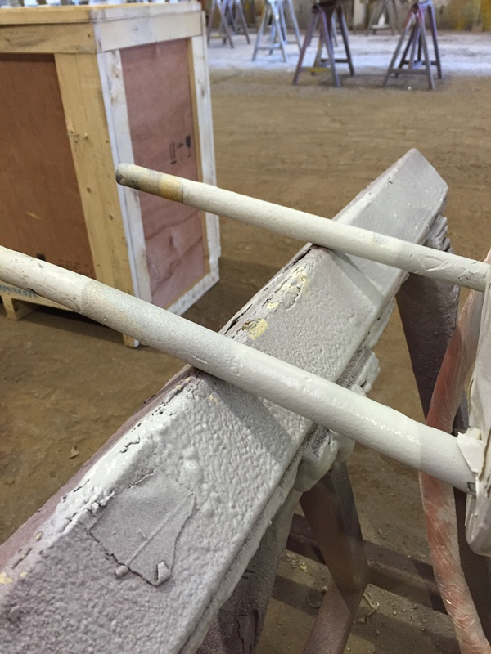
The Audit Team
Transferrable skills – Quality to HSE
It’s important to recognise the risk to the person and not to the product
Everything is underpinned by legislation and not just the standards, i.e. 18001 / 14001
Image shows a spray painting task where the part needs to be suspended but with minimal contact to trestle supports to ensure an even thickness of paint application. However, nobody had considered the strength of the supporting bars and whether or not the part was suspended safely
It wasn’t! Quality was the main focus
Suspending the part like this was not considered within the risk assessment
Job stopped, risk assessment reviewed
Audit trail included training records and content of training to verify if it was appropriate

Slide 7
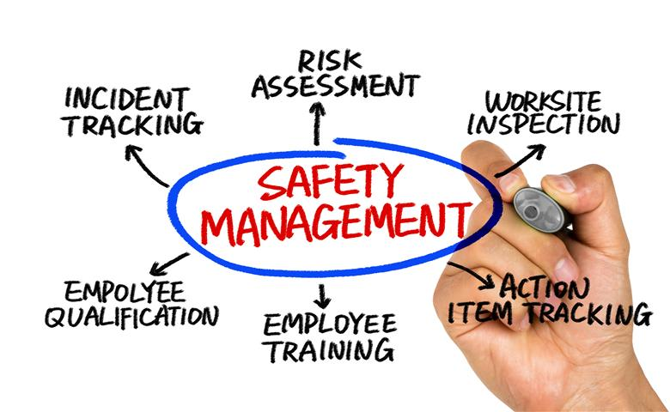
Good Auditor qualities
Is fair
Findings based on evidence
Ethical approach
Question Techniques
  Open
  Leading
  Probing
  Expansive
  Opinion
  Non-verbal
  Repetitive
  Hypothetical
  Closed
Has discretion
Respects confidentiality
Independent
Is trustworthy
Demonstrates integrity
Objective approach

Slide 8
The Audit
Plan
  Objectives / scope / criteria
  Team members
  Areas of audit, i.e. workshop, offices, warehouse, server rooms, etc.
  Reporting requirements for findings and expectations of timescales to closure / update
Prepare
  Contact and inform auditee
  Conducting a document review before the audit can help save time and drive focussed audit areas during the workshop tour
Audit – the tour
  Enter the area, STOP and evaluate. It’s tempting to follow the auditee aimlessly, especially if they are keen to show you something. I’m always mindful that I will typically be unfamiliar with an area and will always ask myself…what can kill me? What can hurt really bad? What can make me ill? Just having a scan about for a minute or two to take in the surroundings using all the senses can only be a good thing. Complacency and ill-considered trust in the auditee is dangerous. No offence to the auditee of course
  Explain what you want to see and ensure you are clear on the site rules, i.e. authorised access areas, PPE, safe routes, first aid, emergency evacuation procedures, etc. Inductions are not always given straight away as I’ve discovered
  Inspect / examine to the necessary depth. If it’s clear the process you are examining is ineffective, so be it, no need to keep going on that path
  Sample objectively (observations, documentation, interviews), gather evidence and discuss with the auditee on your findings, both positive and areas for improvement
  Move on if no significant findings, don’t audit for audit’s sake
  Follow your health and safety radar, your instincts, your senses, your curiosity
  Take yourself off the beaten track if possible. The juicy bits are often found in all the nooks and crannies and these are the true indicators of the tone of the real health and safety culture, not just the tidied up version
  When somebody says ‘yes, it’s in the folder’, ask them to show you. If the risk assessment identifies a documented maintenance programme, ‘show me’. I follow X procedure, ‘show me’. Never tire of the phrase ‘show me’, it’s amazing how often it’s not actually there!

Slide 9

It’s your audit
Control of the audit
  Auditees sometimes talk and talk and talk – keep them focussed on your questions, be polite and professional but firm
  Audit trails – never tire of the phrase ‘show me’
  Disregard – don’t waste time on insignificance
  Note for later – trails may link together for a bigger picture
  Follow up immediately – legal breach, imminent danger, non-conformance
  Close out – be succinct, fair, honest, direct, set clear expectations
  Record and action accordingly – complete report promptly
Evidence Types
  Documentation
  Observation
  Interview

Slide 10
Recognising a finding
Noteworthy Effort (NWE)
  Significant improvements
  Exceeds expectation, best practice
Opportunity for Improvement (OFI)
  Minimum requirement met, but those which could be improved
Observation (OBS)
  Not a non-conformance, but something that could lead to a non-conformance if allowed to continue
Non-Conformance (NC)
  Legal breach
  Deviation from 18001 / 45001 management system requirements
  Process deviation
  No risk assessment / safe system of work
  Ineffective controls

Slide 11
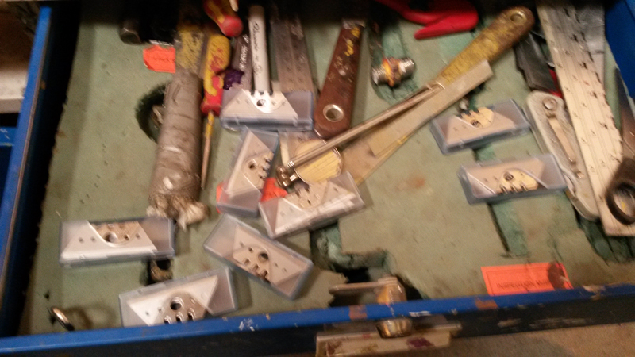
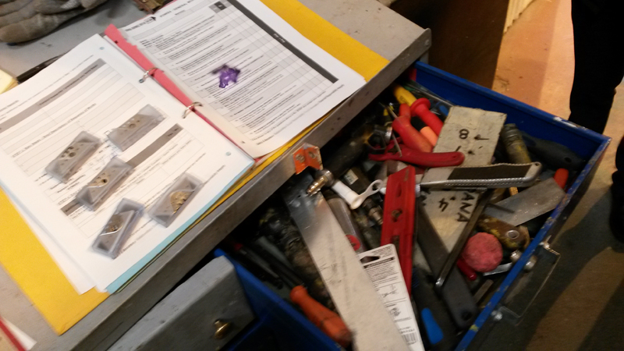
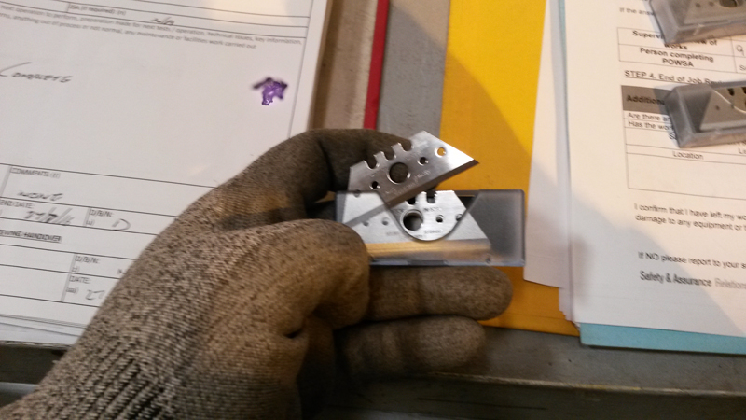
Example 1 – loose blades in messy drawer
Real world examples
Audit area – Paint Shop, a typical toolbox drawer
The blades are easily removed from the blade packs and can end up loose in the drawer. People rummaging in the drawer are at risk of significant cuts.
The blades are used for intricate work when applying masking tape. It transpired that the blades are used loose and not as replacements.
Disposal is into the ‘general’ waste bins, not a dedicated sharps container.
Findings:
NC of knife policy & risk assessment – immediate action – stop using loose blades
OBS – No questions raised as to why so many blades are purchased or removed from stock. Conduct a specific audit of sharps use, purchase and disposal processes
OBS – Review the risk assessment(s) which include intricate tasks to identify safer and easier methods
There is also a supervisory failing here. Additional training may be required for supervisors in the area

Slide 12
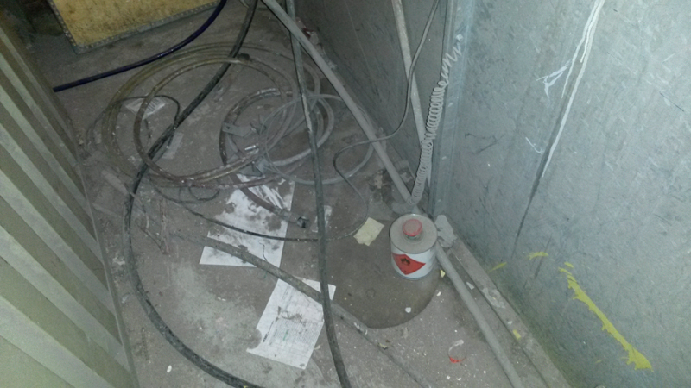
Example 2 – paint shop inspection
Audit area – Paint Shop, one of the ‘nooks and crannies’ behind a paint booth.
Untidy high pressure paint lines, air lines, electrical earth lines, build up of dust and debris, container of flammable thinners, poor lighting.
A housekeeping regime was in place, including an inspection checklist. However, both were clearly ineffective with concerns also being raised regarding high pressure lines and earthing continuity, as well as training for people conducting inspections.
Findings:
NC - Job stop - thorough ‘deep clean’ of work area
OBS - Review of inspection regime, checklist and associated training
OFI - An increase in housekeeping audits for a minimum of six months to provide assurance of the improved housekeeping regime

Slide 13
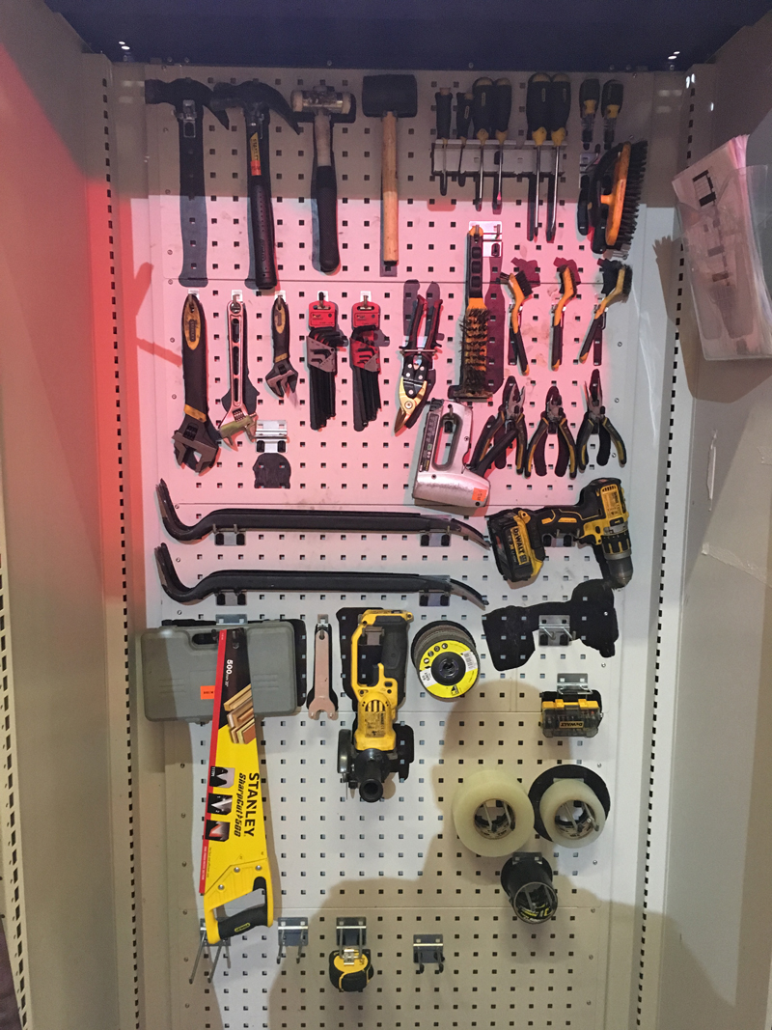
Example 3 – Tool cupboard
It’s also about looking for the positive safe conditions and behaviours.
A well kept tool cupboard with shadow board.
Findings:
NWE - Best practice approach to be shared across the facility and other workshops where possible, i.e. supply chain, customers

Slide 14
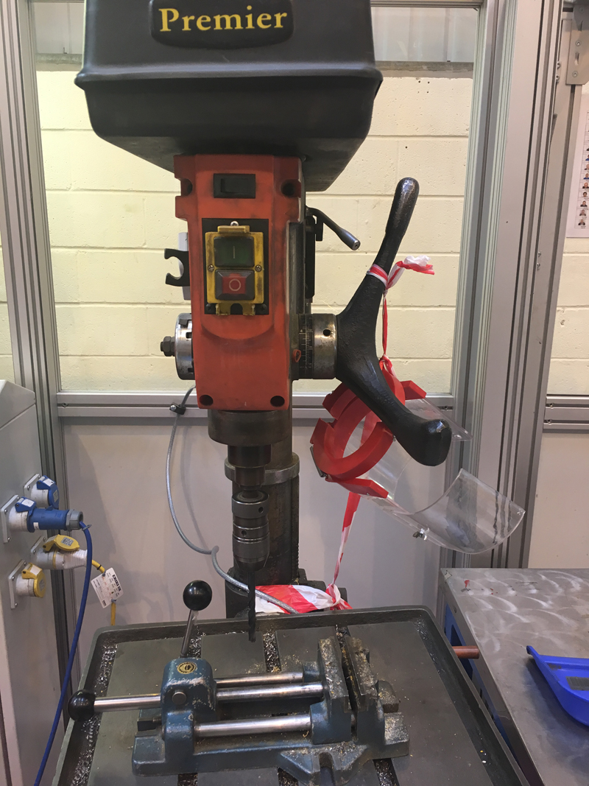
Example 4 – pedestal drill
Cover broken off and missing for emergency stop / go controls.
Adjustable chuck guard broken and not replaced, found on bench, machine still in service.
Immediate action – removal from service, reported to Maintenance for repair.
Findings:
NC – missing guard to prevent access to dangerous rotating machine parts. Also, e-stop / go controls missing the plastic cover – not fit for purpose
Corrective action - supervisor to conduct a behavioural (ABC analysis) and root cause analysis to identify why the machine was not removed from service immediately after breakages
Corrective action - Toolbox talk to be conducted for all personnel using machinery with adjustable guards
Corrective action – review the risk assessment
Interesting article - https://www.machinesafety.co.uk/news/drill-guard-really-necessary/

Slide 15
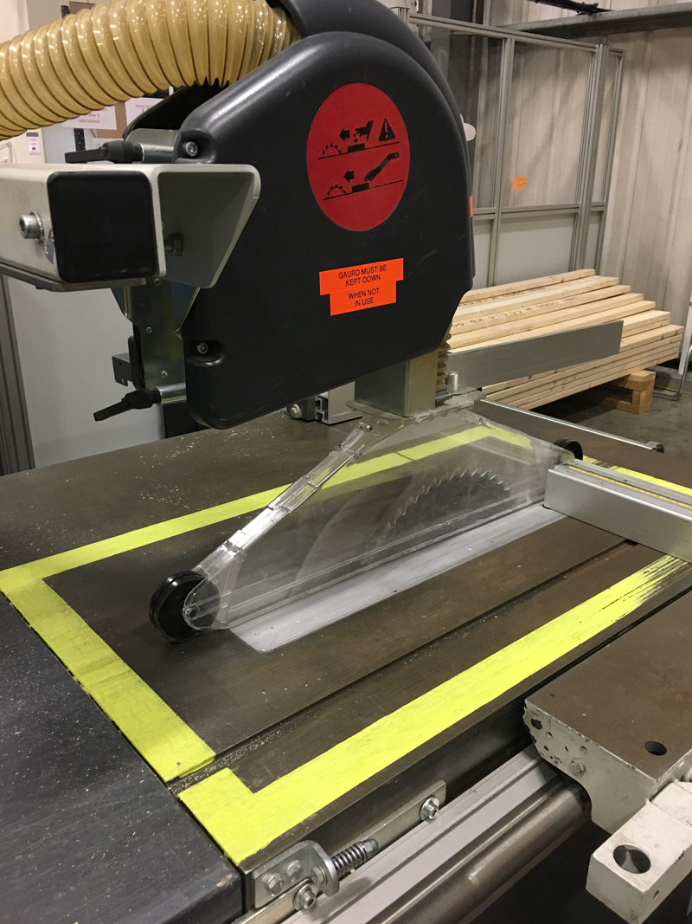
Example 5 – table saw improvements
Another positive example of safe conditions and behaviours.
The operators take pride in their area. It’s clean, tidy and everything has its place.
They also took positive steps to provide additional information stickers and outlined a yellow ‘no go’ zone for hands.
Push sticks must be used at all times.
This is the type of thinking and behaviour leading to a positive health and safety culture.
Findings:
NWE - Best practice approach (behaviours and physical improvements) to be shared across the facility and other workshops where possible, i.e. supply chain, customers

Slide 16
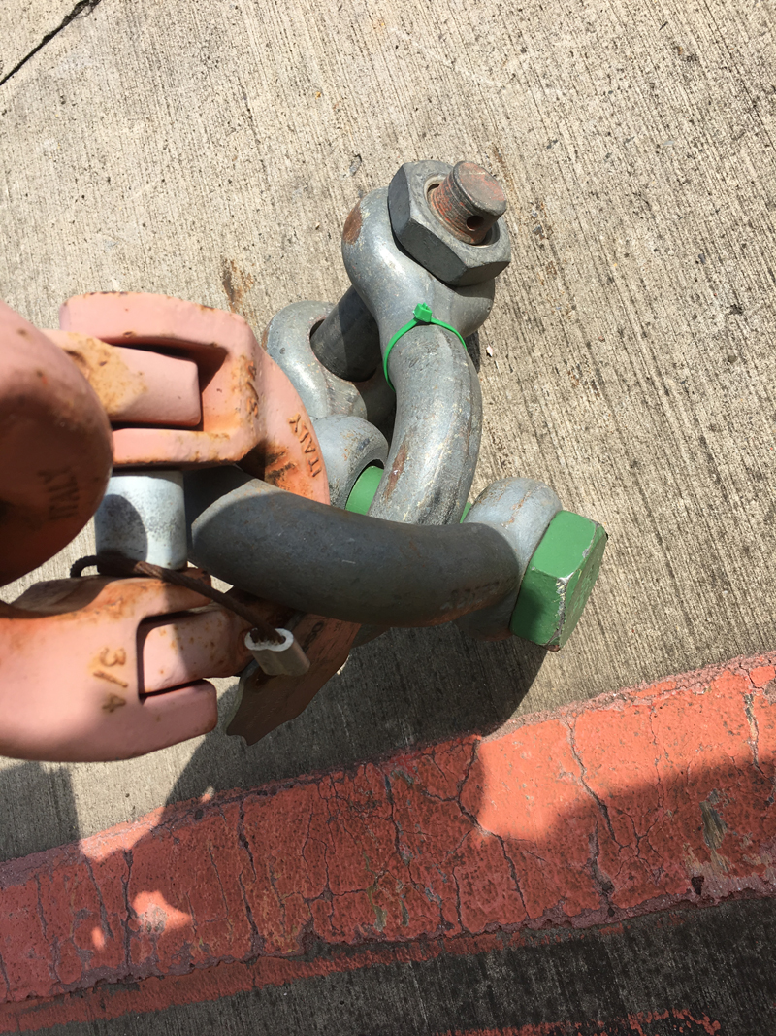
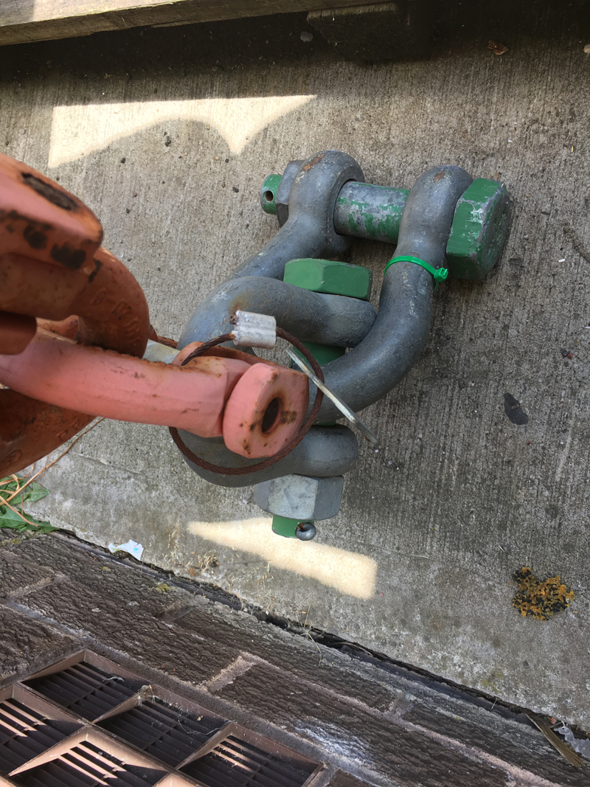
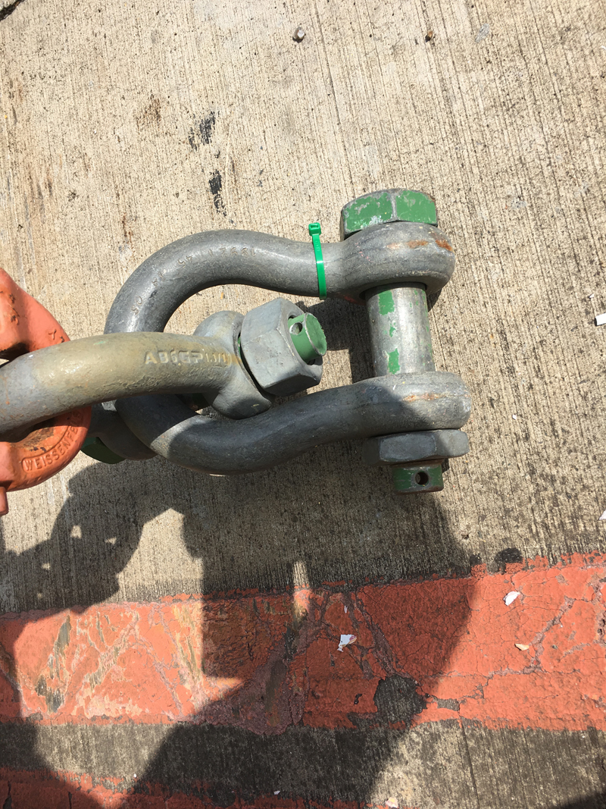
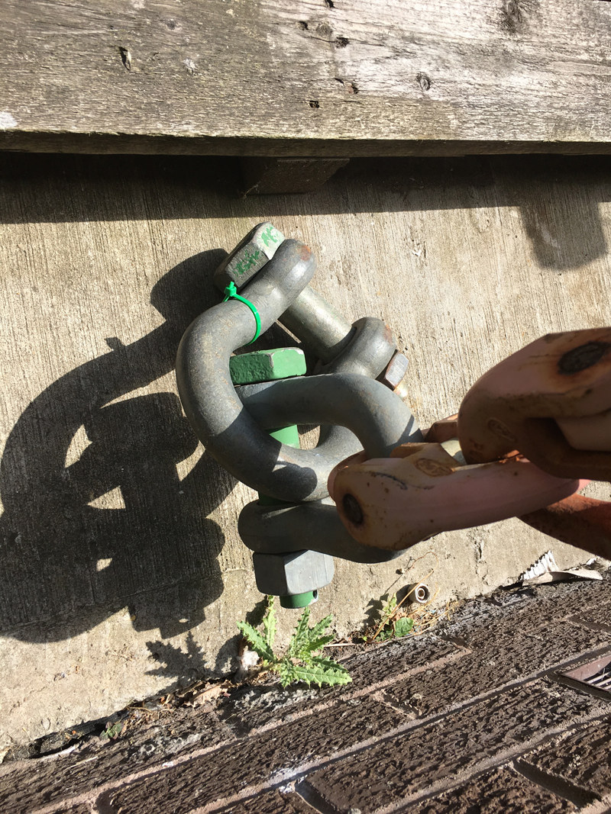
Example 6 – lifting shackles
Although a system is in place for these lifting accessories to satisfy LOLER’s six monthly thorough examination requirements and a green tie wrap is used to identify the current six month period, the shackles were missing the split pin to prevent the nut backing off during operation.
This condition is dangerous and unacceptable.
Findings:
NC to risk assessment requirements – missing split pins
Immediate action – items quarantined and reported to area supervisor
Corrective action – conduct an inspection of all shackles on site to ensure no others are missing split pins
Corrective action – investigate to determine if the split pins were inserted at the time of thorough examination or not. If not, review the competence of examiners and to what set of standards they are operating to
Corrective action – review mechanical lifting training to ensure split pins are included in the training

Slide 17
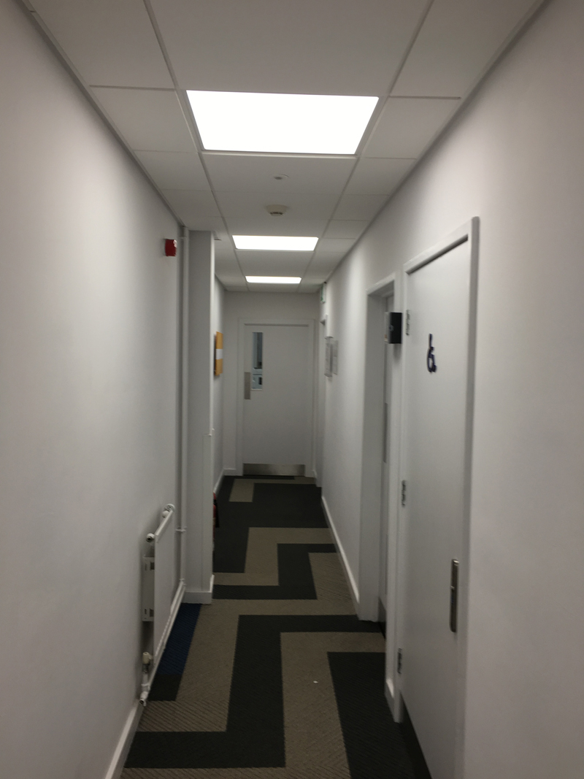
Example 7 – emergency signage
Expect the unexpected.
Photo shows a new build office (occupied) with two emergency escape routes but no emergency signage or lighting.
Findings:
Legal breach – Safety signs and signals Regulations and relevant fire safety Regulations Scotland / England
Corrective action – conduct a review of safety signs on site complete with action plan to rectify findings

Slide 18
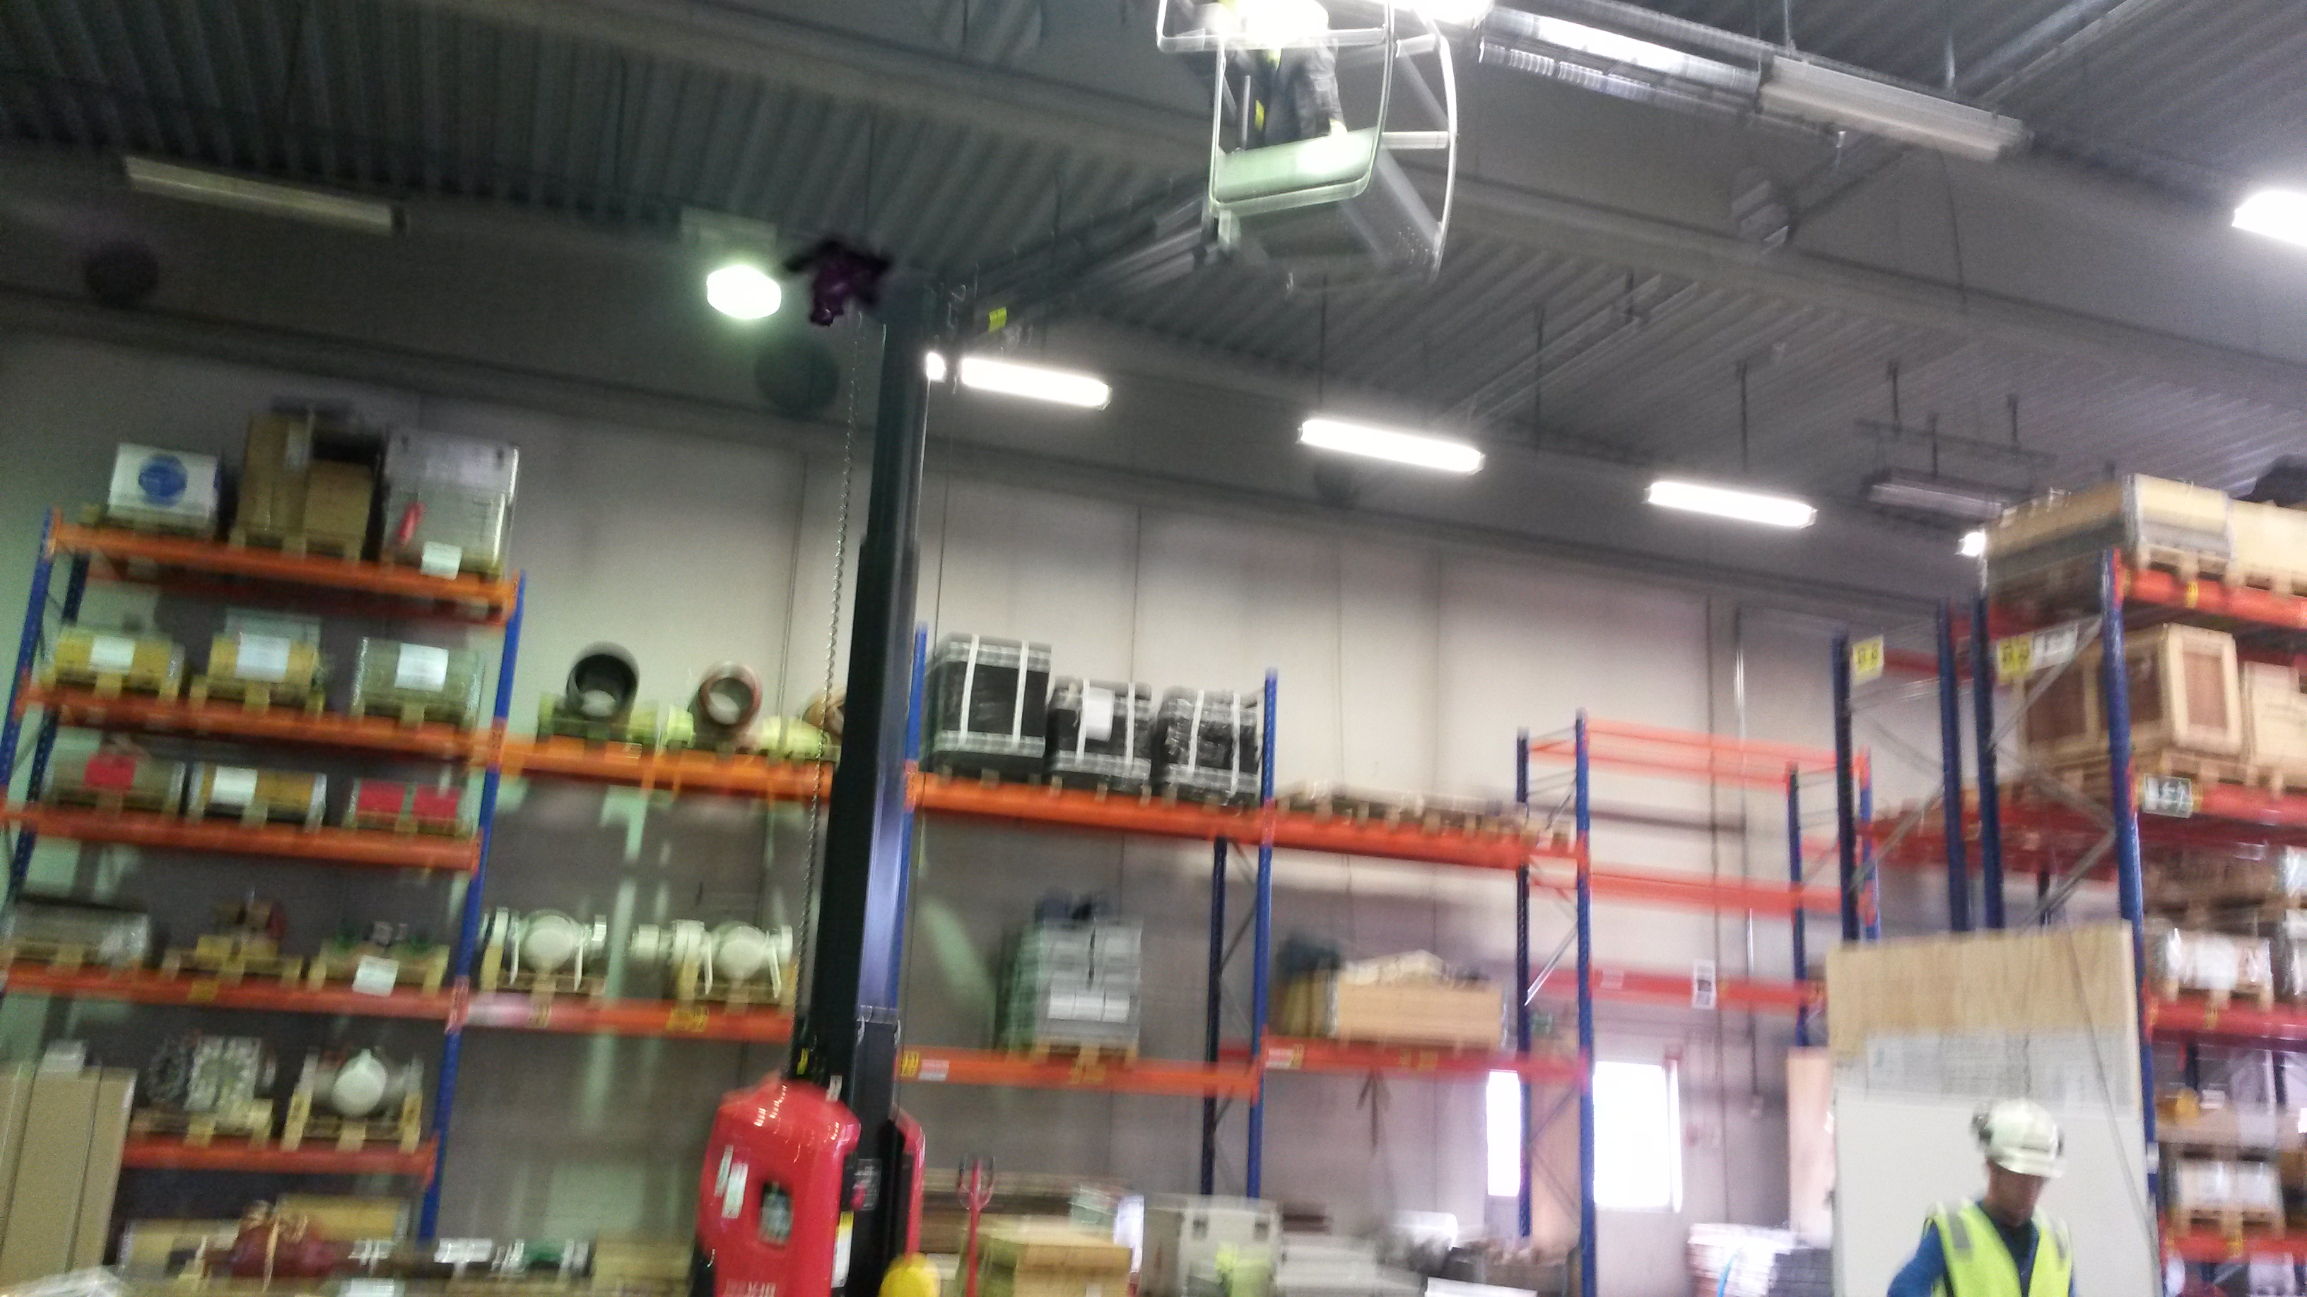
Example 8 – Work at Height – Contractors
The control of contractors (CoC) process is often an area that lets a company down for one reason or another. There’s so many variables influencing behaviours, it’s always a good idea to focus on any contractor works on site during your audit.
Contractors typically work with generic risk assessments trying to capture every hazard under the sun, but companies accepting these assessments without examining and verifying the relevant controls properly are putting people at risk of injury or ill-health.
For example, contractors in the picture above had a risk assessment requiring a harness for the MEWP, he’s not wearing it, he says it’s in the van…show me…he didn’t have it at all.
The assessment requires IPAF trained MEWP operators, he says he is…show me your Powered Access Licence (PAL)…he’s lost it, he says he has a copy back at head office. Well, come down until I see it please!
Remember, never tire of the phrase ‘show me’, it’s amazing how often it’s not actually there!
This example took my audit trail through the CoC process and included: training & competence levels of those engaging with contractors; supervision during works; contractor inductions; contractor competency checks; tools & equipment inspections, including certificates; and, communication between others on site.

Slide 19
Behavioural safety, what does it look like?
Audits shouldn’t just be about YES/NO compliance. Effective auditing will always delve a bit deeper into the WHY, i.e. people’s behaviours, why they do or don’t do something.
My approach is to use the ‘ABC Analysis’ concept to help delve a bit deeper into the more complex areas of behaviours affecting the H&S culture. It can be used for both positive and negative behaviours.
There are a multitude of examples and research on the web for ABC Analysis if you want to learn more about this fascinating subject.
Antecedents
(triggers)
Pressures of work
Laziness
Behaviours
(what’s the issue?)
Positive or negative
Consequences
(payoffs & downsides)
Soon, certain, positives
Delayed, uncertain, negatives
Lack of knowledge
Peer pressure
Custom & practice
Cognitive dissonance
Excuses

Slide 20
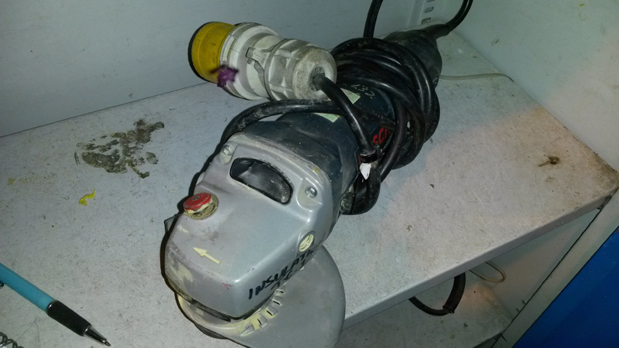
Behavioural safety, what does it look like?
The poor condition of this grinder could take an auditor down the route of maintenance, storage, PAT, training, abrasive wheels, quarantine process, supervision, authorisations, risk assessment, HAVS, etc.
In saying all that, I want to know why the operator chooses to use the grinder without the handle being attached when they know they should.
Antecedents
(triggers)
Pressures of work, time
Everybody uses it like this
Behaviours
(what’s the issue?)
Using an unsafe grinder when they know they shouldn’t
Consequences
(payoffs & downsides)
Soon, certain, positives:
Job gets done
Saves time
Delayed, uncertain, negatives:
Injury
Disciplined
Workspace restrictions
Lost the handle
Custom & practice
Buying new parts takes ages
Corrective actions
Repair / replace grinder & review processes for doing so
Investigate access restrictions, rethink design, sequence of work
Review the training, re-train operators & supervisors
Site survey to identify other defective equipment
Increase observations on using hand held power tools

Slide 21
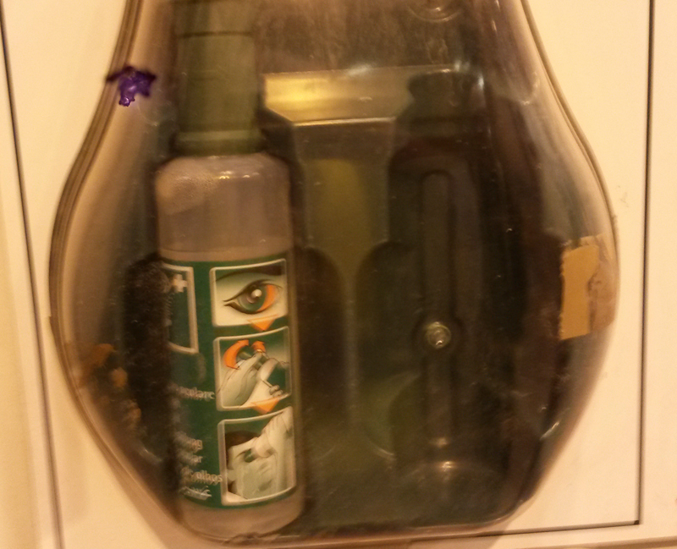
Behavioural safety, what does it look like?
Eyewash station has one bottle missing. Remaining bottle has been used and put back. There has been no incident report, no first aid report, no request to replenish the eyewash bottles; therefore, no corrective action to prevent reoccurrence.
Antecedents
(triggers)
Fear of discipline for not wearing safety specs
Behaviours
(what’s the issue?)
Not reporting an accident, incident, injury, bottles used
Consequences
(payoffs & downsides)
Soon, certain, positives:
Eye gets cleaned
Don’t get into trouble
Saves time
Delayed, uncertain, negatives:
Eyewash not available for others, injury
Disciplined
Fear for job – I’m only a contractor
I don’t have time to report
Lack of understanding of the importance of reporting
I don’t know who to report to
Corrective actions
Replace eyewash
Audit eyewash replenishment process
Develop training for accident reporting
Escalate the contractor’s fears to senior management
Consider a culture climate survey

Slide 22
Behavioural safety, what does it look like?
Concrete slab has risen due to unusually hot weather, causing a trip hazard.
Positive behaviours need to be recognised, even if it’s not exactly as we would want sometimes. This sign isn’t the best, but somebody has taken the time to do something about a trip hazard and it’s still effective.
Antecedents
(triggers)
Don’t want anybody getting hurt
Behaviours
(what’s the issue?)
Doing something rather than nothing
Consequences
(payoffs & downsides)
Soon, certain, positives:
Alerts to hazard
Minimise trip & fall risk
Feels good to help
Delayed, uncertain, negatives:
Not perfect, still a hazard
Want to lead by example
Has a conscience
Understands importance of being proactive
It’s the right thing to do
Corrective actions
Recognition
Positive reinforcement of actions
Simple action = powerful message
Reward individual

Slide 23
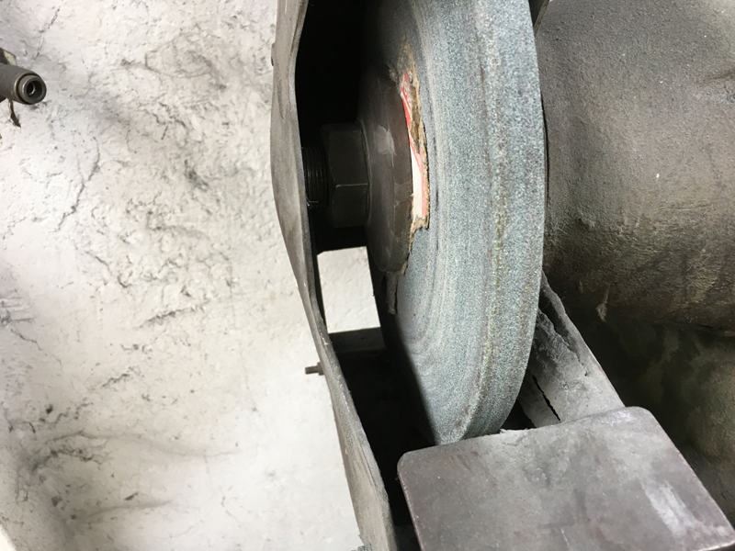
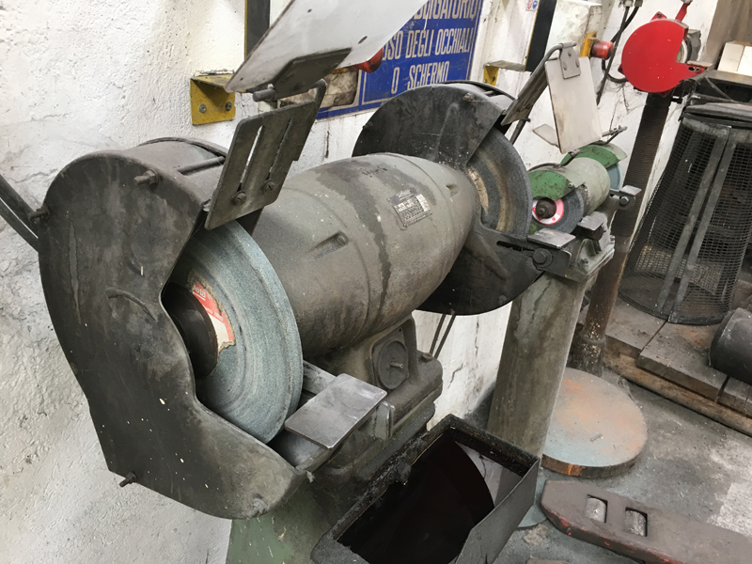
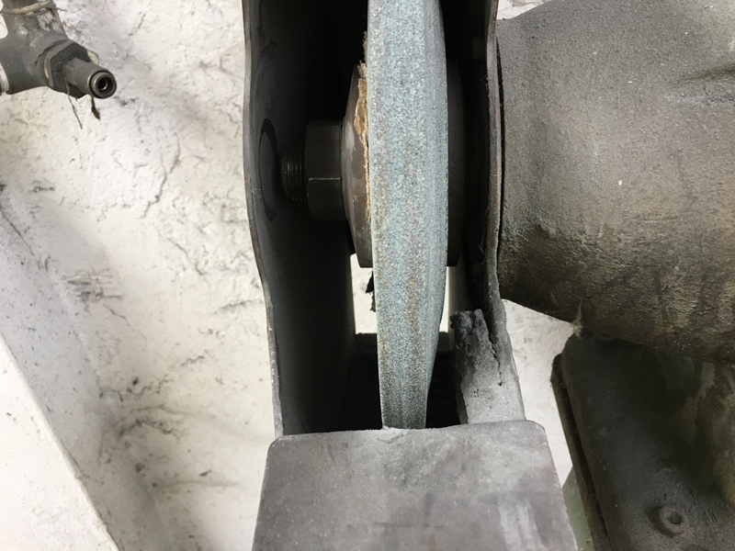
site inspection photos
Abrasive wheel excessively worn on both sides
Incorrectly adjusted guard
Table rest gap too big
No emergency stop, control knob missing

Slide 24
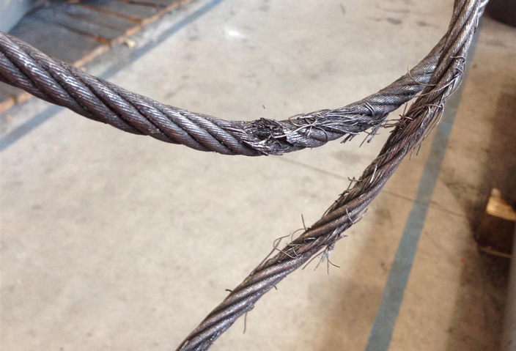
site inspection photos
Significant damage to steel lifting ropes. These were still in use

Slide 25
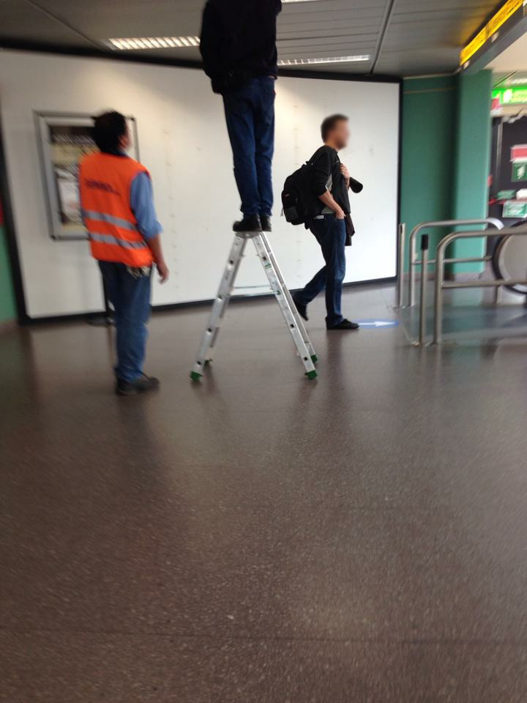
site inspection photos
Milan Airport

Slide 26
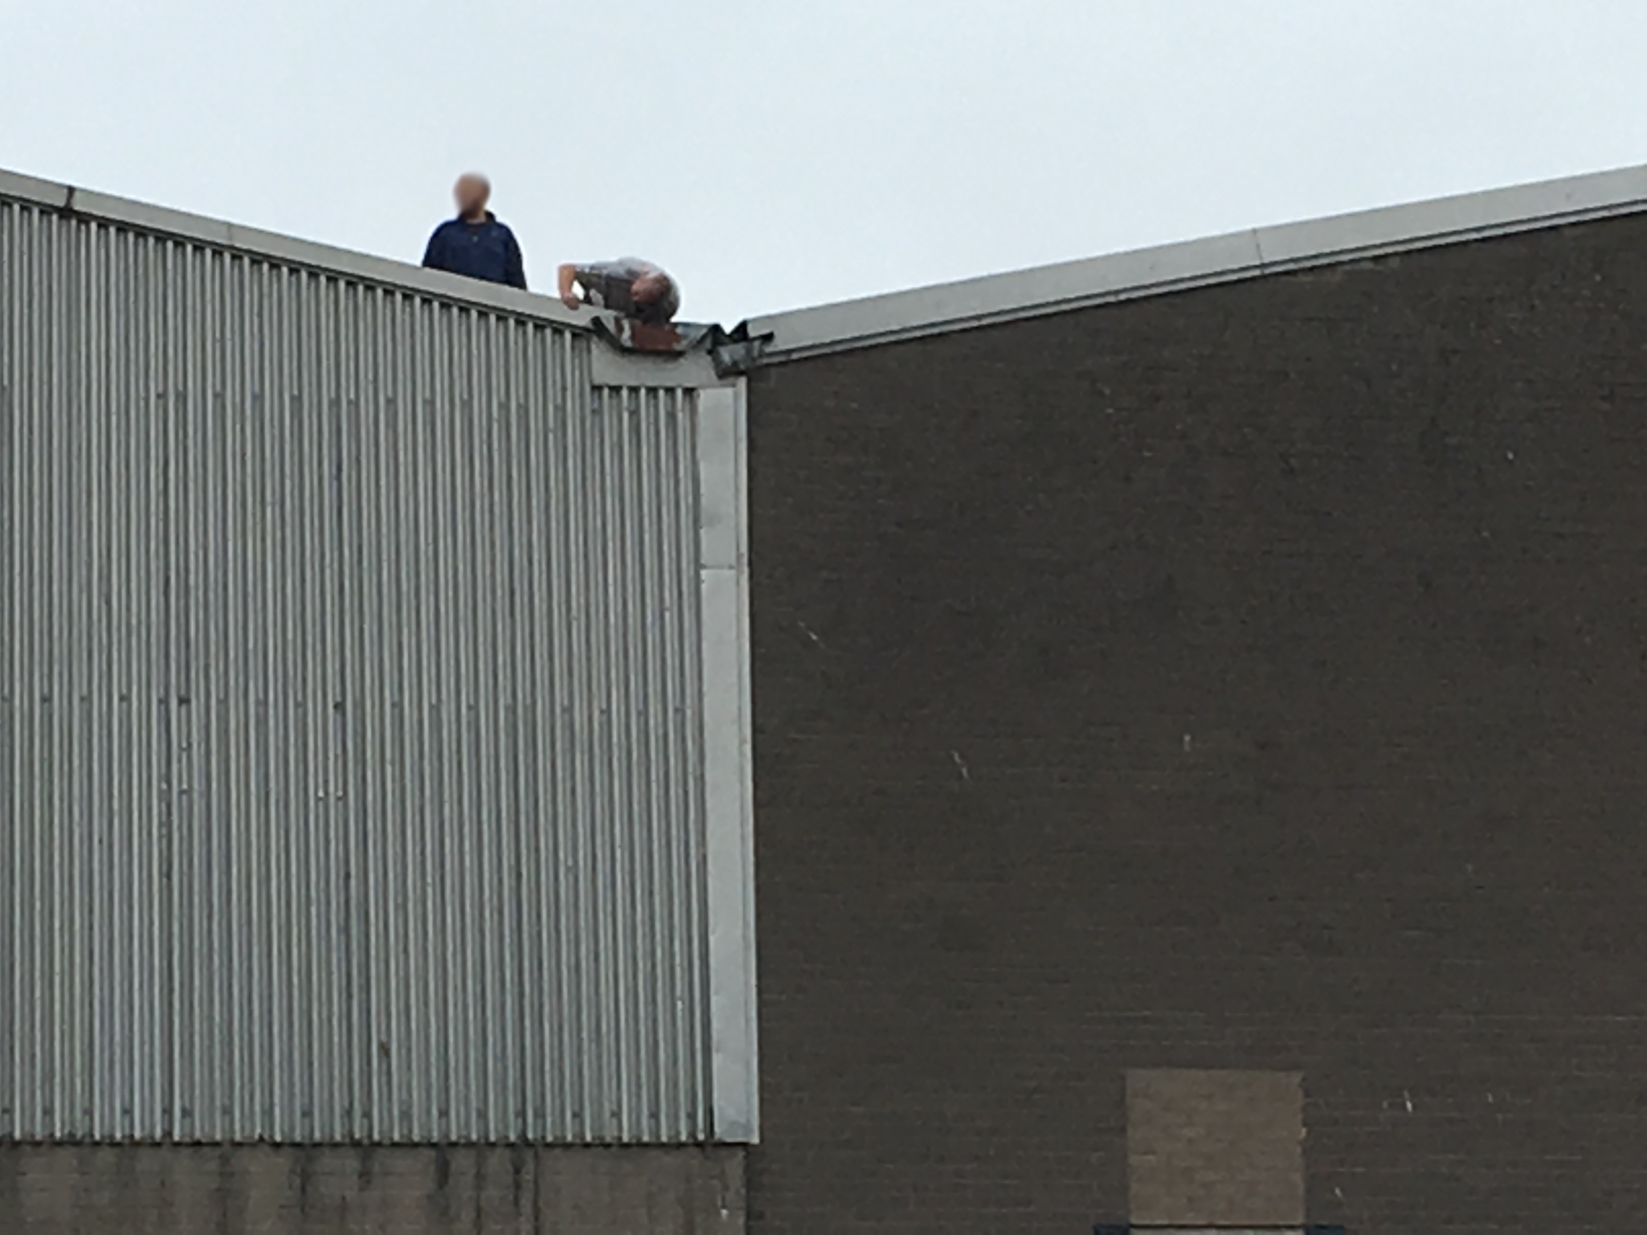
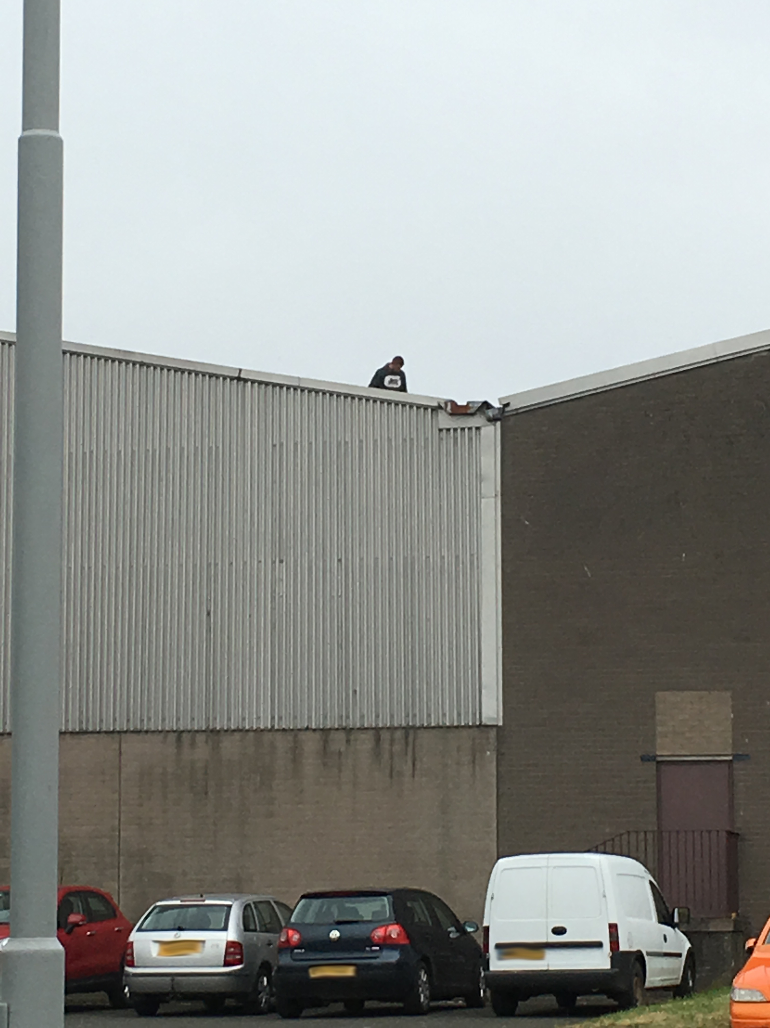
site inspection photos
Workers clearing seagull nests
Zero fall prevention
This is a fragile roof
This incredibly dangerous work was reported to the HSE. No further work like this has been seen since.
Seagulls were happy ☺

Slide 27
There is no such thing as a "stupid" or "daft" health and safety question!
H&S Auditing – Real World Examples
John Johnston
Health and Safety for Beginners
I really hope this presentation is of some use to you. The approach I’ve hopefully demonstrated has served me well over the years. It’s not perfect, but I believe some of the improvements made as a result of my audits have saved lives and prevented injuries and ill-health.
Follow your instincts, your spidy-tingly-senses on the back of your neck, when it just doesn’t look right. Check it out, I bet you’re right ;)
Be respectful and have patience. People just want to work and get paid. Their behaviours and attitudes have likely been ingrained way before you arrived.
Use these words often: what’s that? How does that work? Why? Show me…

