Slide 1
WORKING AT HEIGHTS
Portable Ladders

Slide 2
Sheet 1 - Checking timber ladders
Burns or charring
Splits along
the timber grain
Termite
damage
Cracks across
the timber grain
Moisture
damage

Slide 3
Sheet 2 - Checking metal ladders
Sharp edges and burrs
Twisted or deformed
ladder parts
Metal fatigue and cracks
Loose or missing
screws and rivets
Corrosion due to
contact with acids
or caustic soda

Slide 4
Sheet 3 - Checking single type ladders
Loose or bent
tie rod
Loose rungs
A
Even spacing
between stiles
300mm spacing
A
Stile twisted
or bowed
Loose or missing
tie rod ends
Worn or missing
slip resistant feet

Slide 5
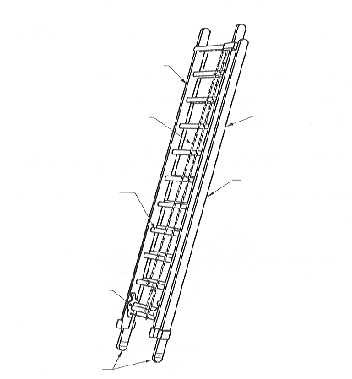
Sheet 4 - Checking extension ladders
Twisted stile
Frayed or cut
haul ropes
Bowed stiles
Loose steel wire
or plastic fibre
reinforcing
Cracked or
loose rungs
Clutch fails
to lock
Condition of
anti-slip feet

Slide 6
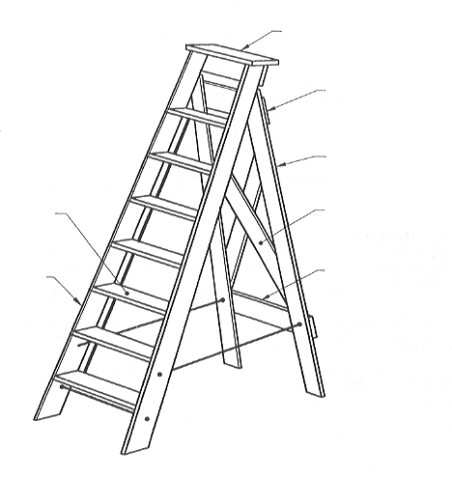
Sheet 5 - Checking step ladders
Seized hinges
Loose top plate
Loose batten
screws
Warped or twisted
back leg
Loose tread or
missing screws
Loose or split brace
Cracked or split
batten
Split or cracked
stile
Frayed or cut cords
Metal spreader arms should be locked into place when the ladder is fully spread

Slide 7
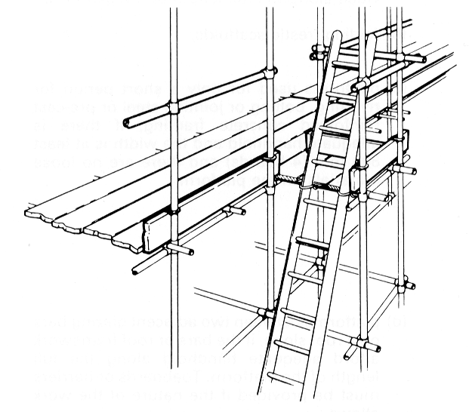
Sheet 6 - Positioning and securing ladders
1 metre extension
past the support
point
Lashed with rope
to prevent movement
Stile feet resting
on a firm and level
surface
4m
Ladder set at a
4 to 1 ratio
1m

Slide 8
Sheet 7 - Using a ladder
One person at a time on the ladder
Face the ladder when climbing up or down
Use both hands
Three point of contact
Use all rungs
Step onto and off the ladder
Keep your body centred between
the stiles
Don’t reach more than arms
length from the stile
Capacity rating of
120 kilograms
Highest standing
point
Ladders with any metal should not be used near electrical power sources

