Slide 1

SHEQXEL™
HSE DASHBOARD TEMPLATES

Slide 2
The Problem Statements
There is/are:
General lack of effective working tools for health and safety
Very expensive proprietary EHS software on the market
Small businesses cannot afford the expensive EHS software
Inadequate support system for the safety department
Inadequate reporting system for health and safety activities
Low motivation for health and safety management
High turnover of safety professionals across organizations
WE HAVE ALL BEEN THERE

Slide 3
SHEQXEL™
THIS WHY WE ARE HERE

Slide 4
Spreadsheet software, the best solution for you…

Slide 5
The Pros of Spreadsheet
Cheapest software on the market
Open source knowledge to all
Easy to customize with good excel know-how
Perfect for data gathering, data analysis and reporting
Available to you already on your computer

Slide 6
Pros of SHEQXEL Solutions
User experience and ergonomics in mind
Result of massive QHSE research
Result of shared experience of great minds
Close substitutes to web based applications
Support Plan, Do, Check and Act cycle in QHSE processes
Support ISO certification through adequacy of reports.

Slide 7
SHEQXEL™
SHEQXEL is founded on the need to make the safety job easier and exciting for safety professionals and organizations

Slide 8
ABOUT US
We build Quality, Health, Safety and Environmental (QHSE) spreadsheet software to improve the efficiency of QHSE professionals.
We also provide support to organizations on QHSE Management System to enable them to achieve ISO certification.

Slide 9

Founder
A QHSE Specialist with over 10 years of progressive QHSE experience in the Oil & Gas industry both upstream and downstream. He holds BA. Economics from University of Ghana, MSc. Oil & Gas Management from Coventry University (UK), IOSH Managing Safely from SMTC, NEBOSH IGC, NEBOSH IOGC, and NEBOSH IDIP from Shields UK, IRCA Lead Auditor ISO 9001:2015 (QMS) & ISO 45001, Radiation Protection Supervisor from ARPS (UK), Kelvin Topset Investigator (UK), H2S Awareness, & Advanced First Aid. He has good technical expertise in developing, implementing, monitoring and evaluating QHSE Management System in accordance with ISO standards. He is the founder and developer of SHEQXEL Applications.
Linkedin: Selorm Ametewee, IDipNEBOSH

Slide 10

OUR VISION
The Hub
To become the hub of affordable turnkey QHSE management system applications and solutions

Slide 11

OUR MISSION
Keeping it simple and sweet
To make QHSE management easy and simple for organizations and safety professionals

Slide 12

Gain Control with SHEQXEL

Slide 13

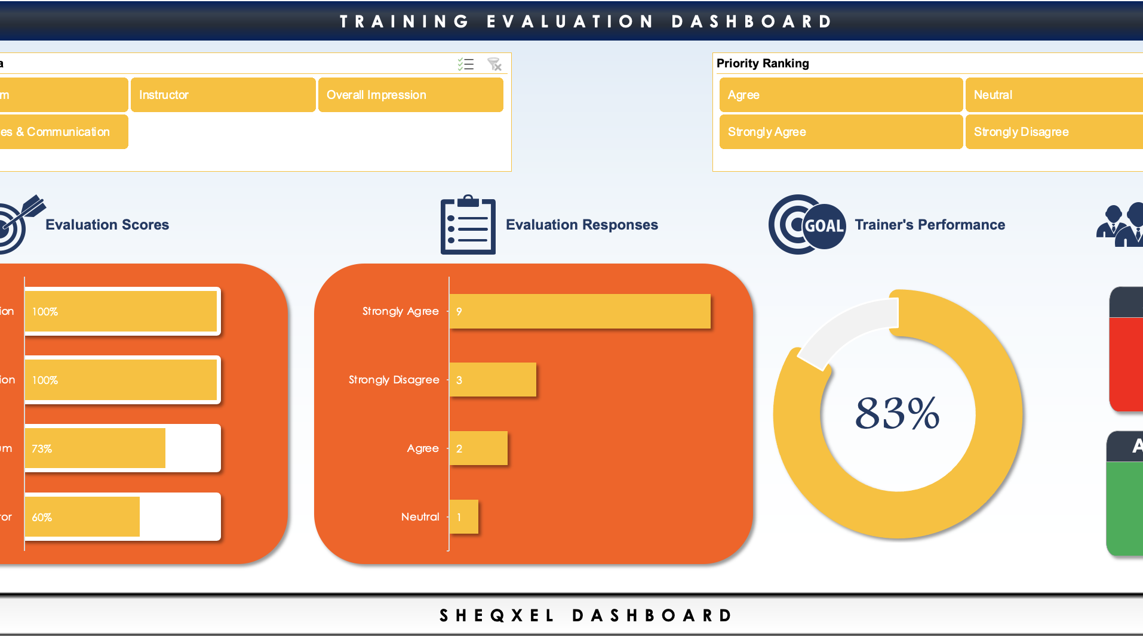
Why Choose SHEQXEL
Quality is our hallmark
Quality Health, Safety and Environment spreadsheet solutions
Affordable spreadsheet solutions
Spreadsheet solutions at cheaper prices
3,000+ happy customers
Safety professionals around the world love our tools
Perfect for ISO certification
Good data gathering, analysis and reporting

Slide 14
Our Support to You
We provide amazing support to all our cherished users
Live Chat
Customization Service
Need a quick fix? Reach us on Live Chat.
Need to adapt the tool? Get a custom service
Book a Meeting
Support Extension
Need one on one meeting? Book a free consult
Need regular support? We’ve got you covered

Slide 15
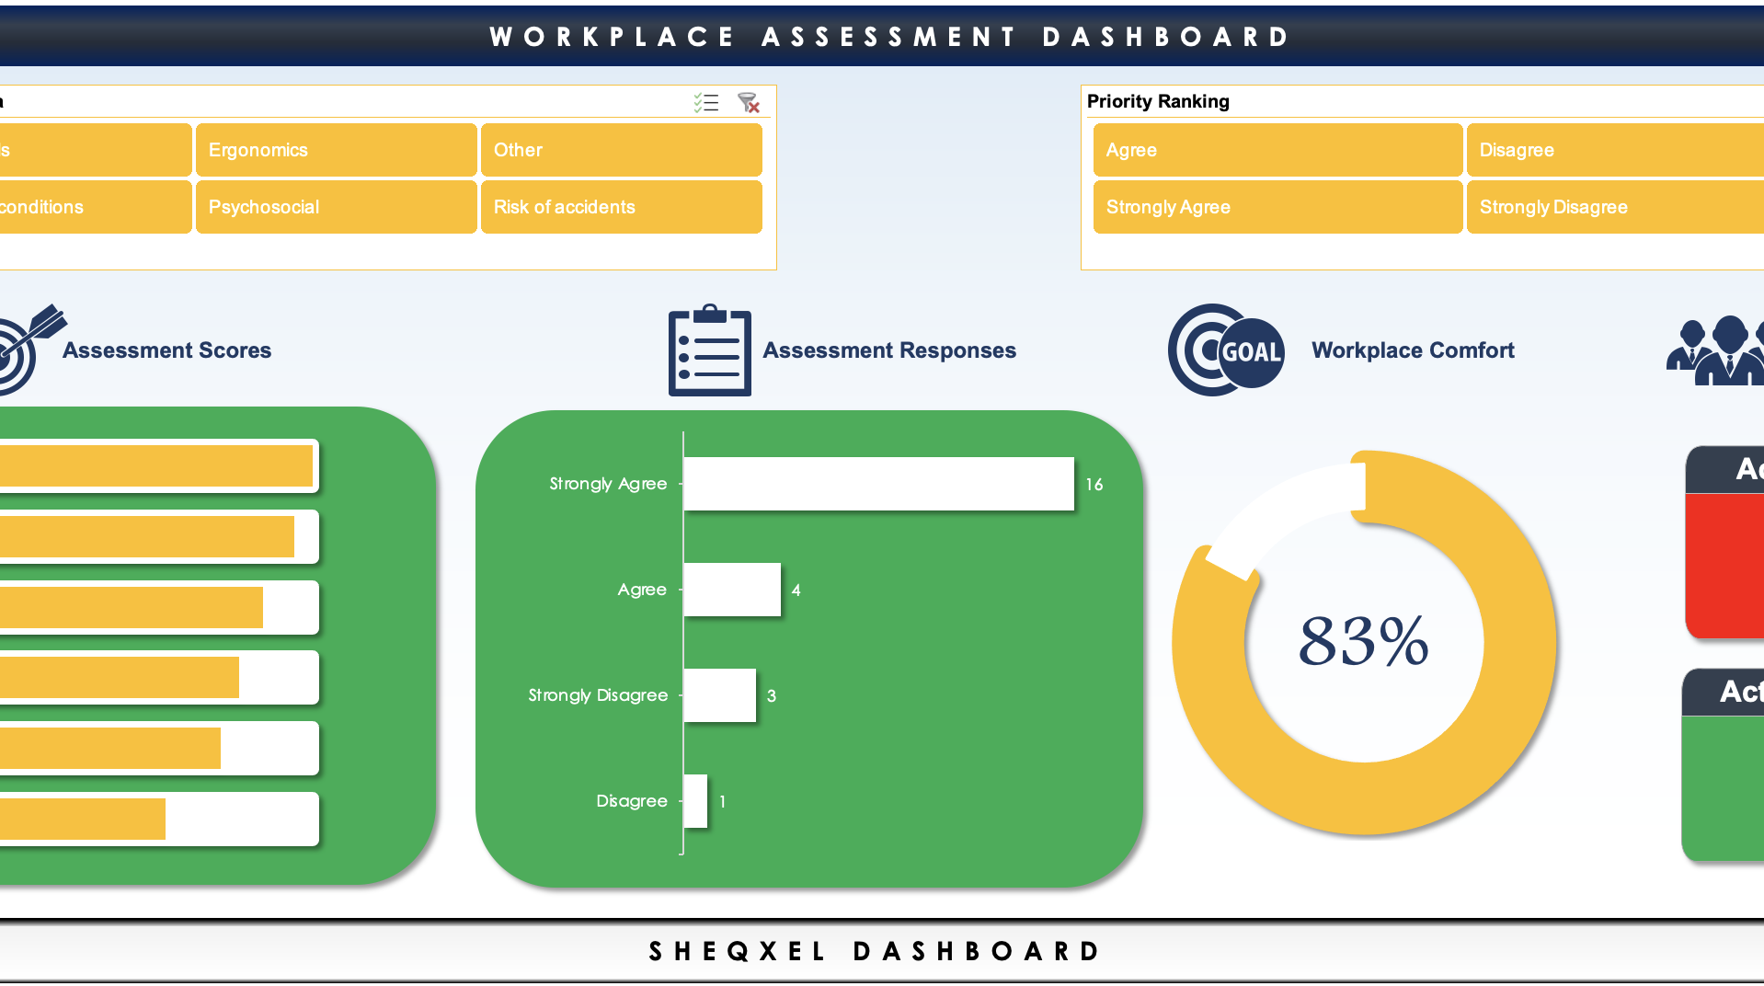
66+ QHSE Dashboard Templates
Ensuring continual improvement of Quality, Health, Safety and Environmental processes just got easier
PLAN
DO
Plan your health and safety activities using your work instructions, forms, checklists, policies and procedures
Carry out your activities, log them and build a database of activities using SHEQXEL tools
CHECK
ACT
Analyze data and measure results, track performance and establish trends using SHEQXEL tools
Identify areas of improvement and implement preventive and corrective actions from results from SHEQXEL tools

Slide 16
PRICING TABLES
Officer’s Pack
Manager’s Pack
Full
Pack
CLICK ME
CLICK ME
CLICK ME

Slide 17












OUR CLIENTS
Our clients are corporate organizations and individual safety professionals

Slide 18
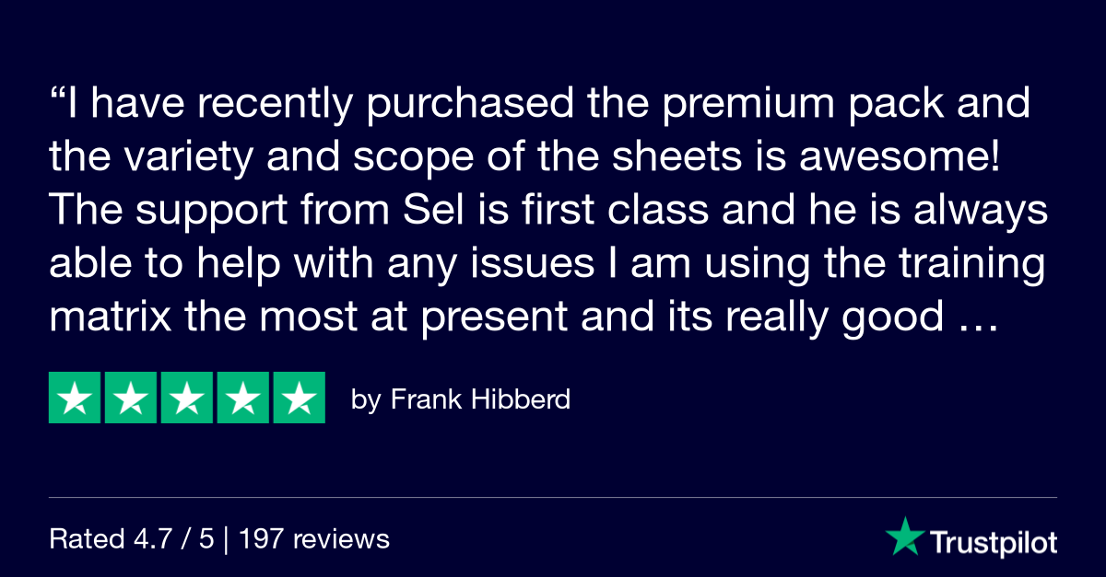
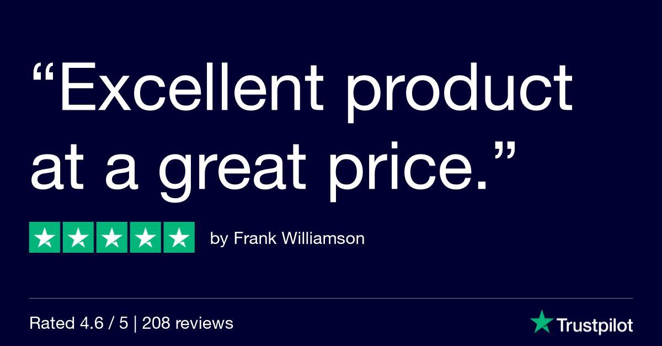
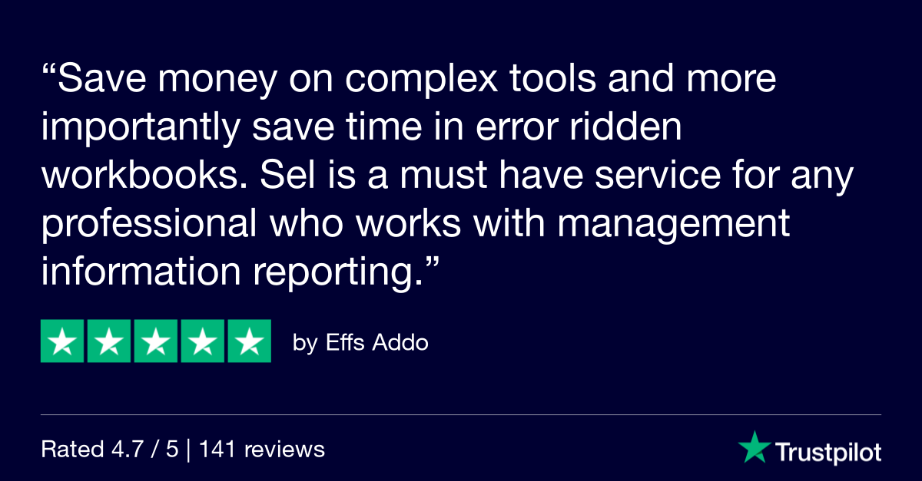
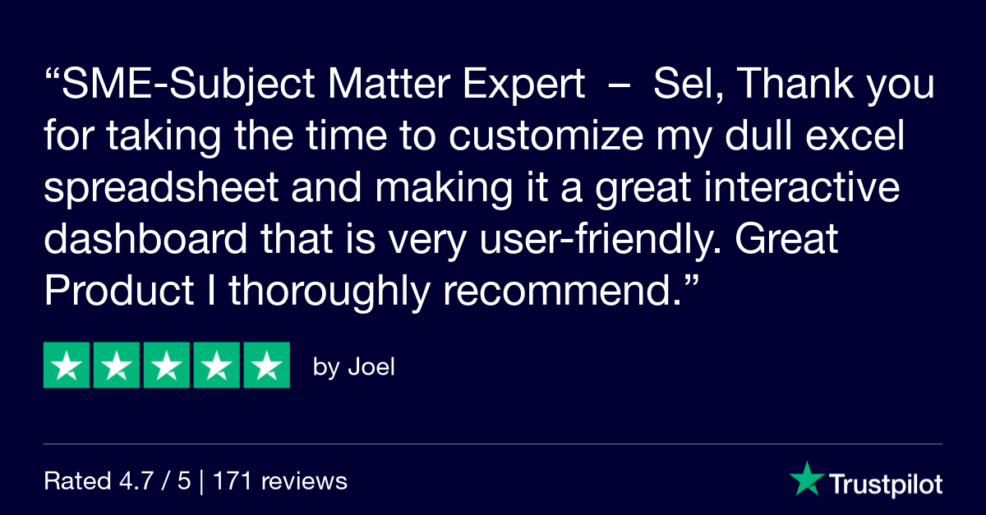
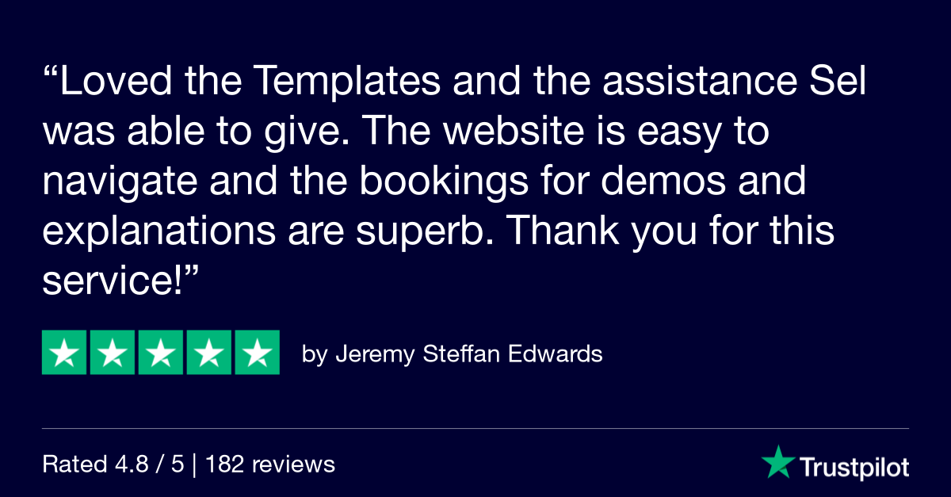
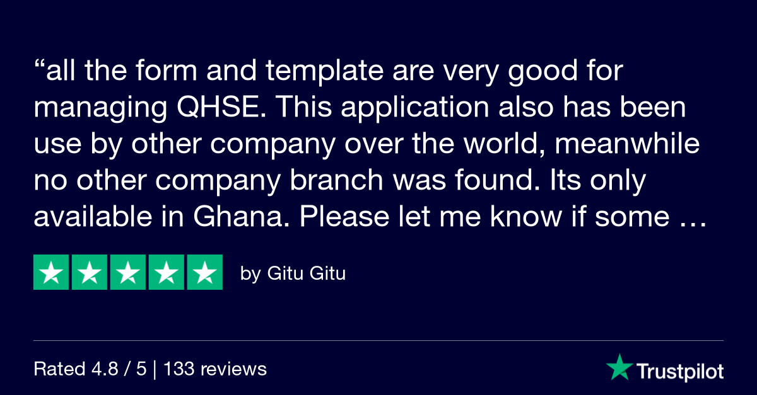
Our reviews

Slide 19
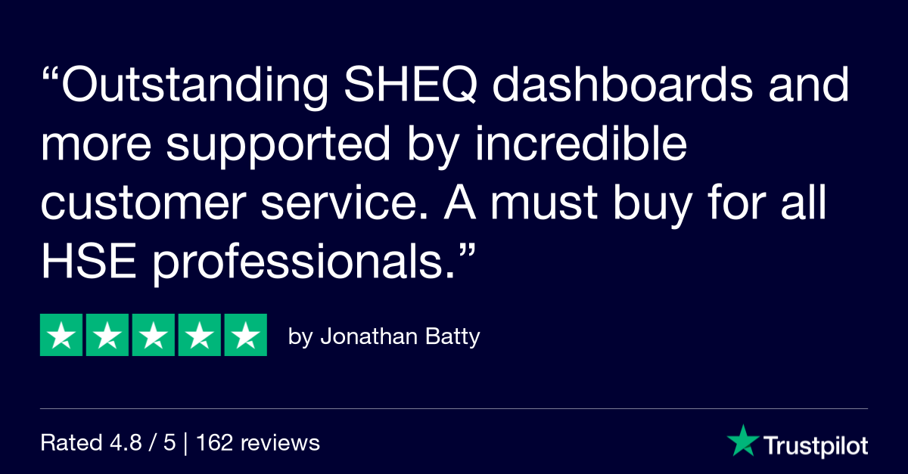
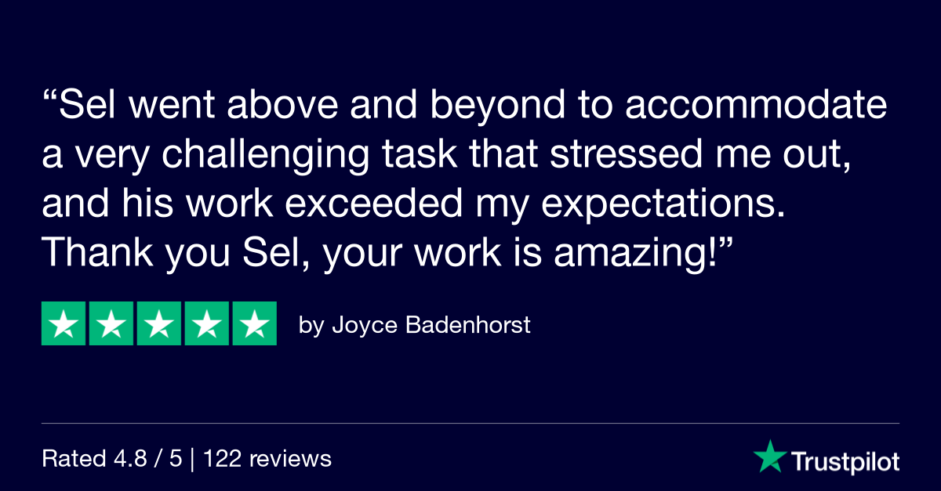
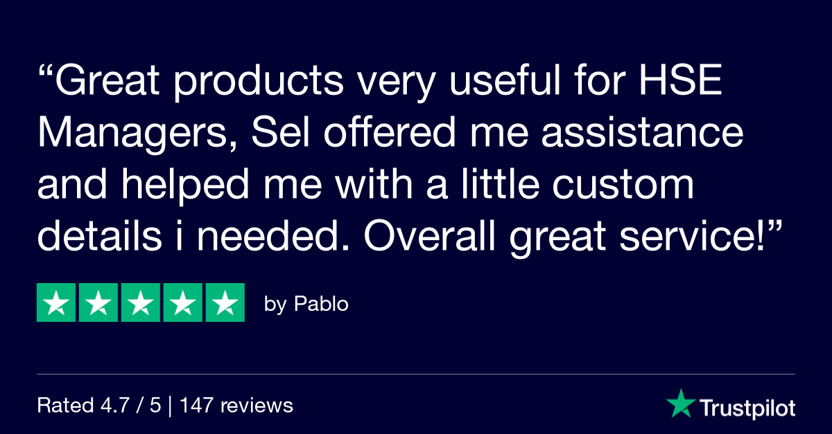
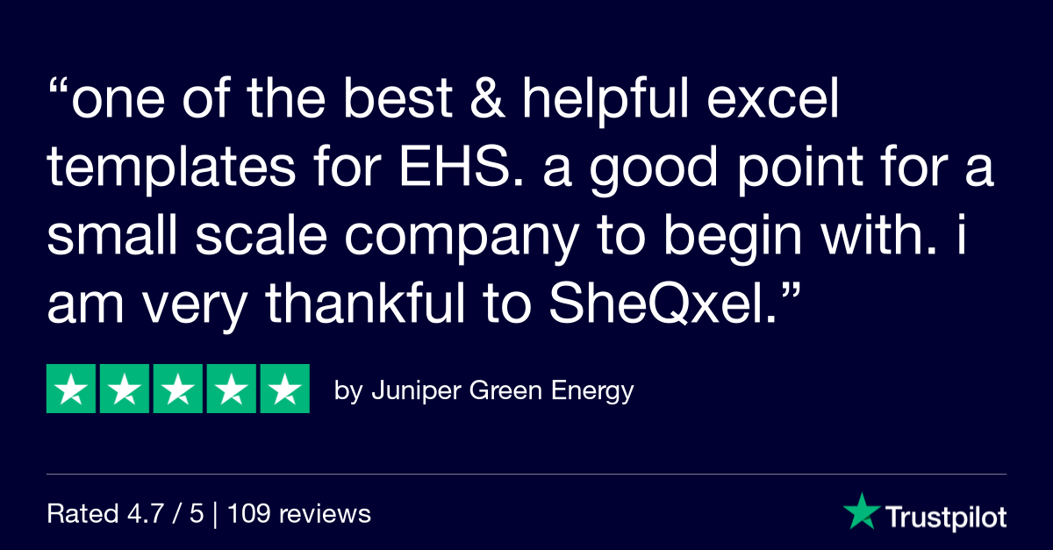
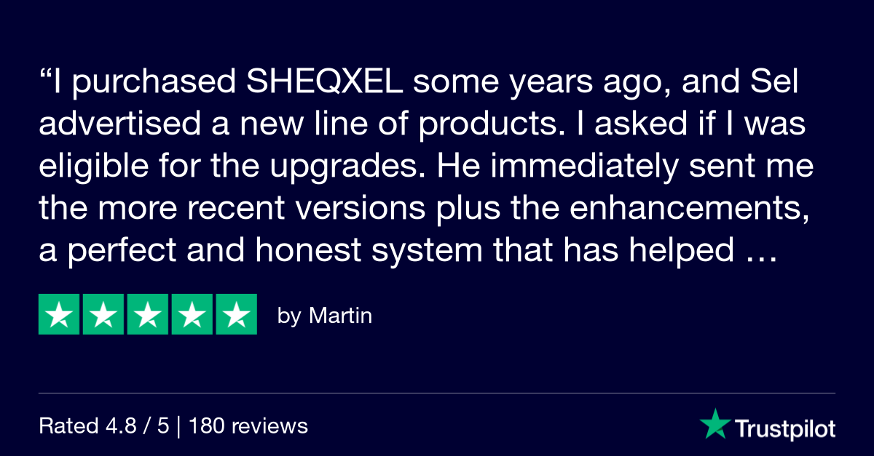
More Reviews

Slide 20
We are Global
Trusted by 3000+ safety professionals around the world
Welcome onboard

Slide 21
66+ QHSE Dashboard Templates
CLICK ME
Free Downloads

Slide 22
Premium Pack Membership
CLICK ME
Join Now

Slide 23
Book a Meeting
CLICK ME
Sel is happy to help

